Slide 1
A parallel fuzzy clustering algorithm for large graphs using Pregel
一种基于Pregel的并行大规模图模糊聚类算法
2018.3.13

Slide 2
1.Abstract
背景及现存问题
  Clustering is used to find existent similar patterns in graphs and thus help in getting useful insights. In real-world, nodes may belong to more than one cluster thus, it is essential to analyze fuzzy cluster membership of nodes.
  聚类用于在图中发现存在的相似模式，从而帮助获得有用的见解。在现实世界中，节点可能属于多个类，因此分析节点的模糊成员关系是必要的。
  Traditional centralized fuzzy clustering algorithms incur high communication cost and produce poor quality of clusters when used for large graphs.
  传统的集中式模糊聚类算法在用于大型图时，会产生较高的通信成本，并得到较差的聚类结果。

Slide 3
1.Abstract
本文方法优势
  It will be advantageous from the viewpoint of expert systems to develop a clustering algorithm that can assure scalability along with better quality of clusters for handling large graphs.
  从专家系统的角度来看，开发扩展性好，并能更好处理大图的聚类算法，是有益的。
  The cluster centers are initialized using degree centrality measure, resulting in lesser number of iterations.
  使用中心度量初始化集群中心，从而产生较少的迭代次数。

Slide 4
1.Abstract
实验对比
  The performance of PGFC is compared with other state of art clustering algorithms using synthetic graphs and real world networks. The experimental results reveal that the proposed PGFC scales up linearly to handle large graphs and produces better quality of clusters when compared to other graph clustering counterparts.
  将PGFC的性能与其他使用人造图和真实网络的前沿聚类算法进行比较。实验结果表明，与其它聚类算法相比，本文提出的PGFC随图形规模线性扩展，并有更好的聚类质量。

Slide 5
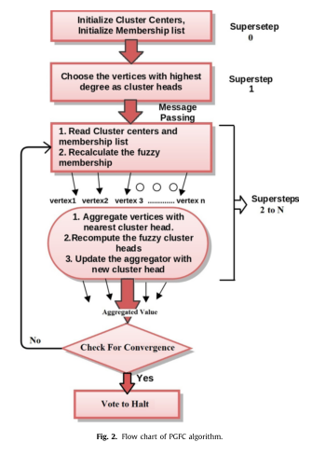
2.PGFC
flowchart of the
PGFC algorithm

Slide 6
2.PGFC
the random initialization of cluster centers leads the iterative process to converge at local optimum solution
in PGFC, instead of choosing cluster heads randomly in beginning, the vertices with high degrees are selected as cluster heads
if two adjacent nodes are chosen as cluster head on the basis of degree, then the node with larger degree is considered as cluster head and the second one is simply ignored.

Slide 7
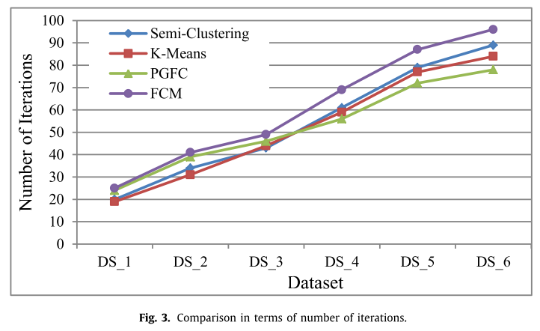
3.Experiments
Number of iterations

Slide 8
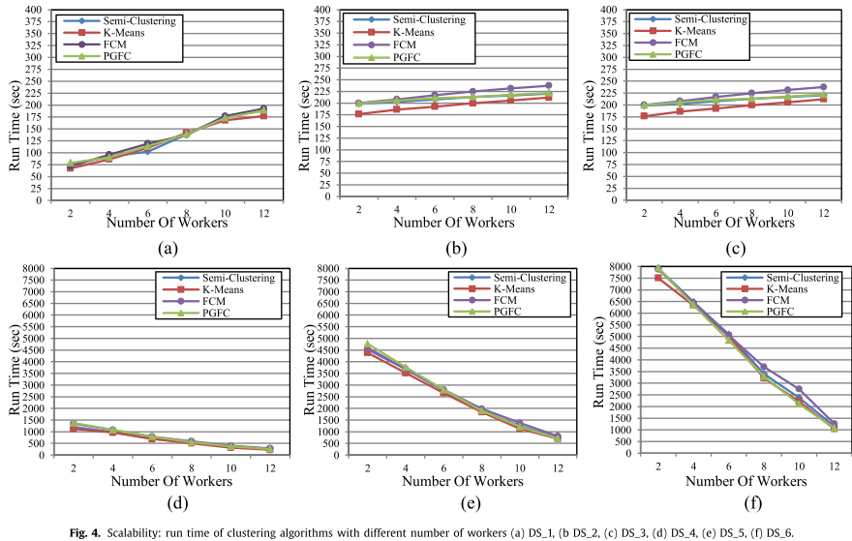
3.Experiments
Run time

Slide 9
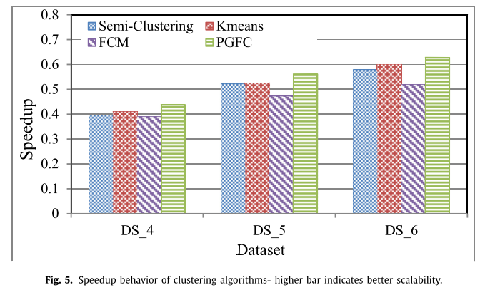
3.Experiments
Speedup behavior

Slide 10
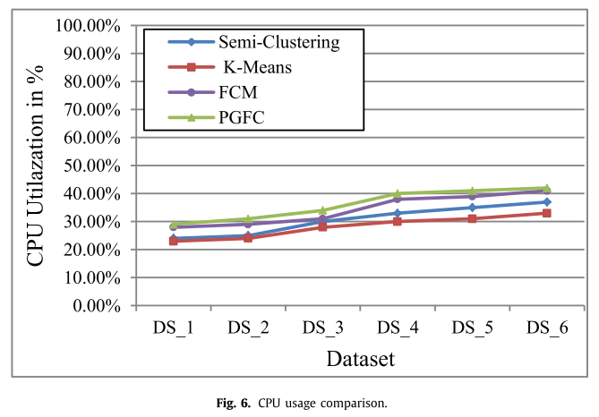
3.Experiments
CPU utilization

Slide 11
THANKS

